Slide 1
Sampling Methods for Extremely Imbalanced Data
Chris Kuo, Ph.D.| Columbia University

Slide 2
What is imbalanced data?
Statement of the problem
Notes:
This is the question that your experiment answers

Slide 3
Imbalanced data
A dataset is imbalanced if at least one of the classes constitutes only a very small minority.
Imbalanced data prevail in banking, insurance, engineering and many other fields.
It is common in fraud detection that the imbalance is on the order of 100 to 1.

Slide 4
Why can’t an ROC curve measure well?
Statement of the problem
Notes:
This is the question that your experiment answers

Slide 5
The Receiver operating characteristic (ROC) curve
Consider an insurance company who needs to know a claim is fraudulent or not. The company needs to predict claims that may be fraudulent and take steps to prevent.
Suppose 2% of 10,000 claims are fraudulent. If the data scientist predicts that ALL claims are not fraudulent, he gets 98% accuracy in the ROC curve. However, the data scientist totally missed the 2% true fraudulent claims.
The ROC curve does not measure well for imbalanced data.

Slide 6
The Receiver operating characteristic (ROC) curve
 | Actual positive | Actual negative
Predicted positive | TP | FP
Predicted negative | FN | TN
Name | Metric
True Positive Rate (TPR) | TP/(TP+FN)
False Positive Rate (FPR) | FP/(FP+TN)
Recall | TP/(TP+FN)
Precision | TP/(TP+FP)

Slide 7
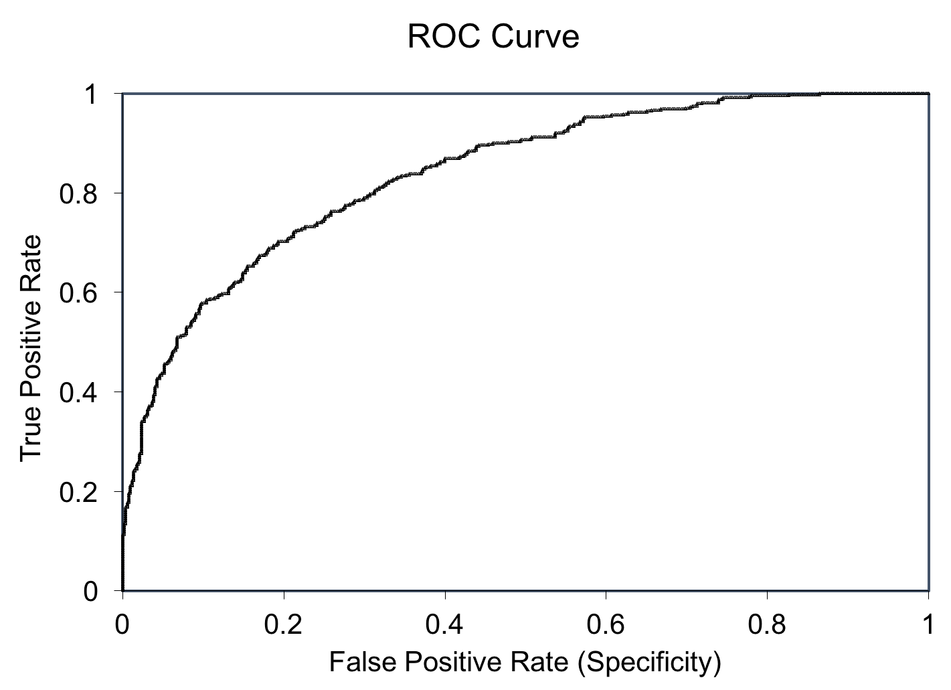
The Receiver operating characteristic (ROC) curve
Because TPR only depends on positives, ROC curves do not measure the effects of negatives.
The area under the curve (AUC) assesses overall classification performance. AUC does not place more emphasis on one class over the other, so it does not reflect the minority class well.
TP/(TP+FN)
FP/(FP+TN)

Slide 8
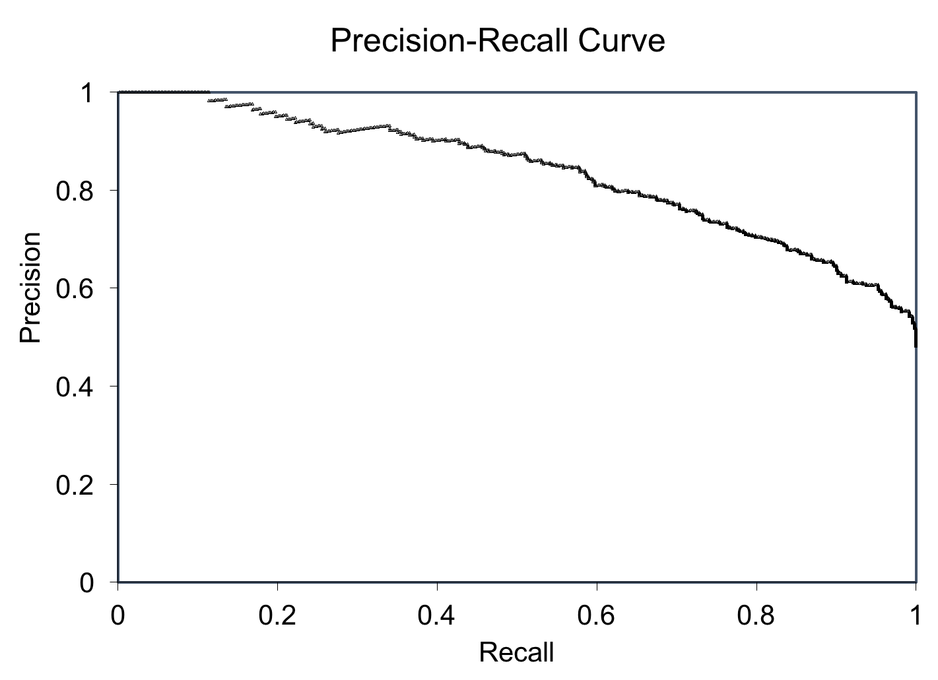
Should use the Precision-Recall curve
The Precision is directly influenced by class imbalance so the Precision-recall curves are better to highlight differences between models for highly imbalanced data sets.
By Davis and Goadrish in a well-cited paper.
TP/(TP+FP)
TP/(TP+FN)

Slide 9
Q. What are the remedies?
Statement of the problem
Notes:
This is the question that your experiment answers

Slide 10
Under-sampling
Random sample
Near Miss
Over-sampling
Random sample
Synthetic Minority Oversampling Technique (SMOTE)
Condensed Nearest Neighbor Rule (CNN)
TomekLinks
Edited Nearest Neighbor Rule (ENN)
Neighborhood Cleaning Rule
Cluster Centroids
ADASYN: Adaptive Synthetic Sampling¶
Notes:
Summarize your research in three to five points.

Slide 11
NearMiss
The one cl
Notes:
Summarize your research in three to five points.

Slide 12
Condensed Nearest Neighbor Rule (CNN)
The
Notes:
Summarize your research in three to five points.

Slide 13
TomekLinks
The
Notes:
Summarize your research in three to five points.

Slide 14
Edited Nearest Neighbor Rule (ENN)
The
Notes:
Summarize your research in three to five points.

Slide 15
NeighbourhoodCleaningRule
The
Notes:
Summarize your research in three to five points.

Slide 16
ClusterCentroids
The
Notes:
Summarize your research in three to five points.

Slide 17
Over-sampling for the minority class
Random oversampling for the minority class
Synthetic Minority Oversampling Technique (SMOTE)
ADASYN: Adaptive Synthetic Sampling¶
Notes:
Summarize your research in three to five points.

Slide 18
Synthetic Minority Oversampling Technique (SMOTE)
The
Notes:
Summarize your research in three to five points.

Slide 19
ADASYN: Adaptive Synthetic Sampling¶
The
Notes:
Summarize your research in three to five points.

